Slide 1
Software Design
Lecture 11

Slide 2
Content
Requirements Engineering
Achieving Quality Attributes
Attribute-Driven Design (ADD)

Slide 3
References
Len Bass, Paul Clements, Rick Kazman, Software Architecture in Practice, Second Edition, Addison Wesley, 2003, ISBN: 0-321-15495-9
Felix Bachmann, Len Bass, Mark Klein, Deriving Architectural Tactics: A Step Toward Methodical Architectural Design,
TECHNICAL REPORT CMU/SEI-2003-TR-004
IBM Rational
Microsoft MSF
http://www.cs.uu.nl/wiki/bin/view/Swa/CourseLiterature

Slide 4
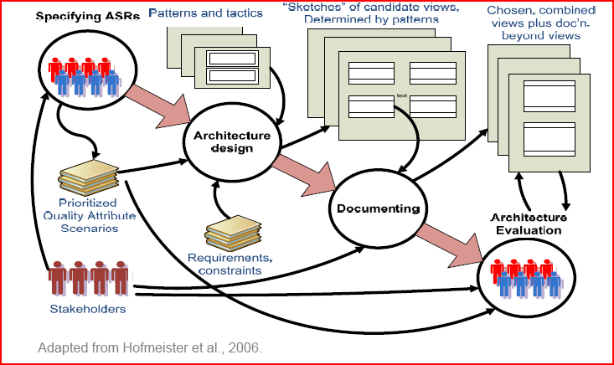
Software Architecture Process

Slide 5
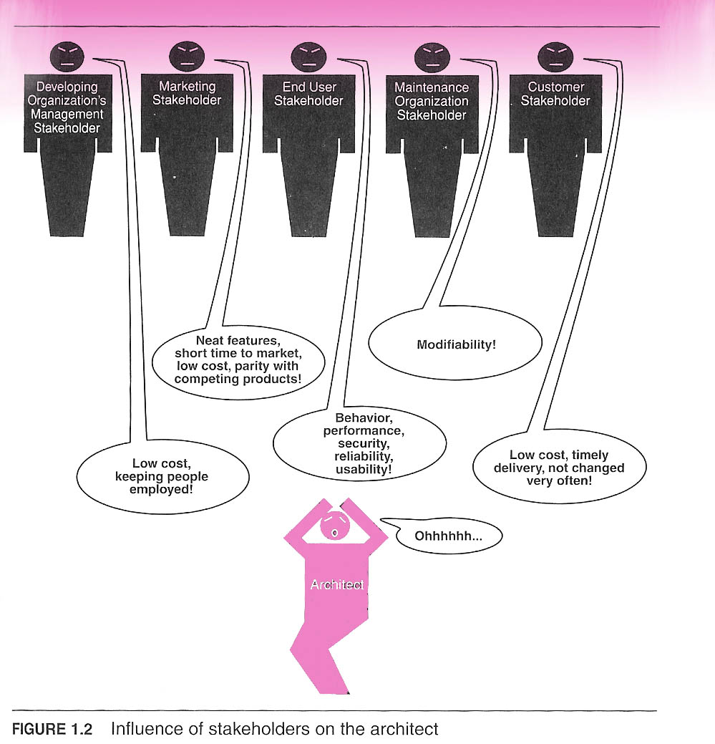
Stakeholders
Developing Organization Management
Marketing
End User
Maintainenace Organization
Customer

Slide 6
Requirements elicitation
Requirements elicitation = the activities involved in discovering the requirements of the system
Techniques:
Asking: interview, (structured) brainstorm, questionnaire
Task analysis
Scenario-based analysis: ‘think aloud’, use case analysis
Ethnography: active observation
Form and document analysis
Start from existing system
Prototyping
Own insight
General advice: use more than one technique!

Slide 7
Requirements specifications
Requirements specification = rigorous modeling of requirements, to provide formal definitions for various aspects of the system
Requirements specification document should be
as precise as possible: starting point for architecture/design
as readable as possible: understandable for the user
Other preferred properties:
Correct
Unambiguous
Complete
Consistent
Ranked for importance
Verifiable
Modifiable
Traceable

Slide 8
Specification techniques
Specification techniques:
Entity-Relationship (E-R) modeling
Use cases (UML)
Epics and User stories

Slide 9
Requirements validation
Requirements validation = checking the requirements document for consistency, completeness and accuracy
Validation of requirements needs user interaction
Techniques:
Reviews (reading, checklists, discussion)
Prototyping
Animation

Slide 10
Use-cases
Technique for specifying functional requirements (What should the system do?)
A use case captures a contract between the stakeholders of a system about its behavior
The use case describes the system’s behavior under various conditions as the system responds to a request from one of the stakeholders, called the primary actor
Use cases are fundamentally a text form describing use scenarios

Slide 11
Basic use-case format
Use case: <use case goal>
Level: <one of: summary level, user-goal level, subfunction>
Primary actor: <a role name for the actor who initiates the use case>
Description: <the steps of the main success scenario from trigger to goal delivery and any cleanup after>
Extension: <alternate scenarios of success or failure>

Slide 12
Use-cases: best practices
A use case is a prose essay
Make the use cases easy to read
Sentence form for the scenario: active voice, present tense, describing an actor successfully achieving a goal
Include sub-use cases where appropriate
Keep the GUI out
Use UML use case diagrams to visualize relations between actors and use cases or among use cases. Use text to specify use cases themselves!
It is hard, and important, to keep track of the various use cases

Slide 13
Functional requirements
Pitfalls:
Undefined or inconsistent system boundary (scope!)
System point of view instead of actor centered
Inconsistent actor names
Spiderweb actor-to-use case relations
Long, too many, confusing use case specifications, incomprehensible to customer
Beware of:
‘Shopping cart’ mentality
The ‘all requirements are equal’ fallacy
Stakeholders who won’t read use case descriptions because they find them too technical or too complicated

Slide 14
Architectural drivers
Functionality is the ability of the system to do the work for which it was intended
Functionality may be achieved through the use of any number of possible structures
=> functionality is largely independent of structure
Architecture constrains the mapping of functionality on various structures if quality attributes are important

Slide 15
Architectural drivers [2]
Get the functionality right and then accommodate nonfunctional requirements – NOT POSSIBLE!!!
Non-functional requirements must be taken into account EARLY ON!!!
There are two broad categories of non-functional requirements (Design-time and Run-time)

Slide 16
Software Architecture and Quality Attributes
Quality isn’t something that can be added to a software intensive system after development finishes
Quality concerns need to be addressed during all phases of the software development.
BUSINESS GOALS determine the qualities attributes, which are over and above of system’s functionality!!!

Slide 17
Quality requirements objectives
Input for architecture definition
Driving architecture evaluation
Communicating architectural parts and requirements
Finding missing requirements
Guiding the testing process

Slide 18
Quality requirements: best practices
Not all quality attributes are equally important: prioritize!
Make the quality requirements measurable
Not: ‘The system should perform well’ but ‘The response time in interactive use is less than 200 ms’
Link the quality requirements to use cases
Example: ‘The ATM validates the PIN within 1 second’

Slide 19
Change scenarios
Some quality requirements do not concern functionality but other aspects of the system. These cannot be linked to any use case
Mainly attributes from Maintainability and Portability, e.g. Changeability and Adaptability
Link these quality requirements to specific change scenarios
Not ‘The system should be very adaptable’ but ‘The software can be installed on all Windows and Unix platforms without change to the source code
Not ‘The system should be changeable’ but ‘Functionality can be added to the ATM within one month that makes is possible for users to transfer money from savings to checking account

Slide 20
Constraints
Functional and quality requirements specify the goal, constraints limit the (architecture) solution space
Stakeholders should therefore not only specify requirements, but also constraints
Possible constraint categories:
Technical, e.g. platform, reuse of existing systems and components, use of standards
Financial, e.g. budget
Organizational, e.g. processes, availability of customer
Time, e.g. deadline

Slide 21
Achieving quality
Once determined, the quality requirements provide guidance for architectural decisions
An architectural decision that influences the qualities of the product is sometimes called a tactic
Mutually connected tactics are bundled together into architectural patterns: schemas for the structural organization of entire systems

Slide 22
Types of requirements (FURPS model)
Functionality
feature sets
capabilities
security
Usability
human factors
aesthetics
consistency in the user interface
online and context-sensitive help
wizards and agents
user documentation
training materials
Reliability
frequency and severity of failure
recoverability
predictability
accuracy
mean time between failure

Slide 23
Types of requirements [2]
Performance
speed
efficiency
availability
accuracy
response time
recovery time
resource usage
Supportability
testability
extensibility
adaptability
maintainability
compatibility
configurability
installability
localizability (internationalization)

Slide 24
Quality attributes
Business quality:
Time to market – “Time”
Cost and benefit – “Economy”
Projected lifetime – “Form”
Target market – “Function”
Rollout schedule – “Time”
Integration with legacy – “Time”

Slide 25
Quality attributes
Architectural quality
Conceptual integrity
Correctness and completeness
Buildability

Slide 26
Quality Attributes
System quality
Availability
Performance
Security
Modifiability
Testability
Usability

Slide 27
System Quality attributes
Are defined in terms of scenarios
source of stimulus [the entity (human or another system) that generated the stimulus or event.] who?
stimulus [a condition that determines a reaction of the system.] what?
environment [the current condition of the system when the stimulus arrives.] when?
artifact [is a component that reacts to the stimulus. It may be the whole system or some pieces of it.] where?
response [the activity determined by the arrival of the stimulus.] which?
response measure [the quantifiable indication of the response.] how?

Slide 28
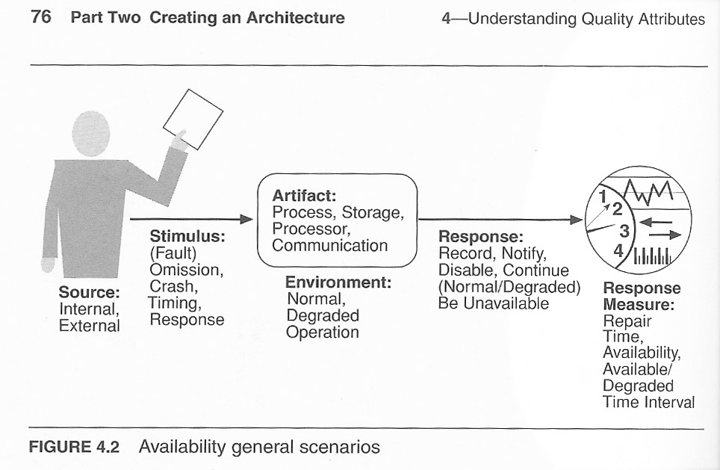
General Scenario

Slide 29
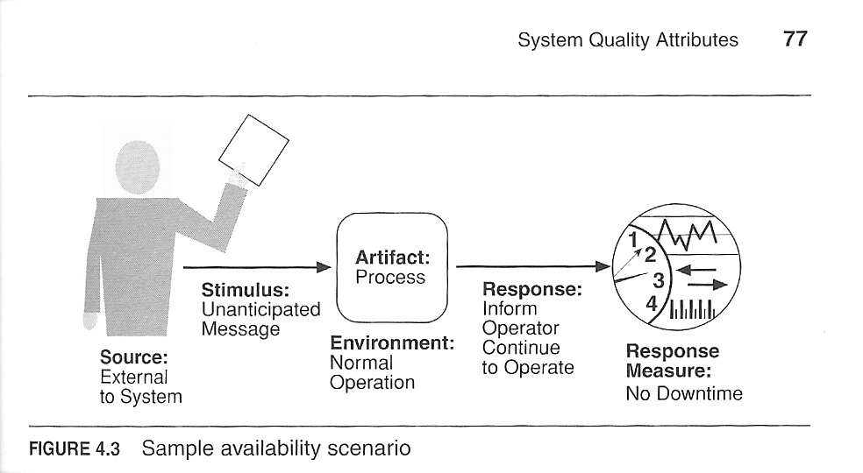
Concrete Scenario

Slide 30
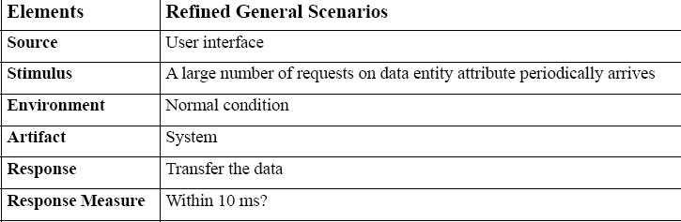
Example
A large number of requests periodically arrives on an individual data entity attribute from a user interface at the system under normal condition. The system has to transfer the data within a certain amount of time without generating too many network calls

Slide 31
Availability
typically defined as the probability of a system to be operational when needed in terms of
mean time to failure / (mean time to failure + mean time to repair)

Slide 32
Availability scenario
Source of stimulus: internal or external
Stimulus:
omission: a component fails to respond to an input.
crash: a component repeatedly suffers omission faults.
timing: a component responds, but the response is early or late.
response: a component responds with an incorrect value.
Artifact: the resource that is required to be available (i.e. processor, communication channel, process, or storage device).

Slide 33
Availability Scenario
Environment: defines the state of the system when the fault or failure occurred: normal, degraded
Response: logging, notification, switching to backup, restart, shutdown
Response measure:
the availability percentage,
a time for repair,
certain times during which the system must be available,
the duration for which the system must be available.
Notes:
Environment: defines the state of the system when the fault or failure occurred. It may also affect the desired system response. For example, if the system has already seen some faults and is operating in other than normal mode, it may be desirable to shut it down totally. However, if this is the first fault observed, some degradation of response time or function may be preferred.

Slide 34
POS – Quality Attribute Scenario 1
Scenario(s): The barcode scanner fails; failure is detected, signalled to user at terminal; continue in degraded mode
Stimulus Source : Internal to system
Stimulus: Fails
Environment: Normal operation
Artefact (If Known): Barcode scanner
Response: Failure detected, shown to user, continue to operate
Response Measure: No downtime, React in 2 seconds

Slide 35
POS – Quality Attribute Scenario 2
Scenario(s): The inventory system fails and the failure is detected. The system continues to operate and queue inventory requests internally; issue requests when inventory system is running again
Stimulus Source : Internal to system
Stimulus: Fails
Environment: Normal operation
Artefact (If Known): Inventory system
Response: Failure detected, operates in degraded mode, queues requests, detects when inventory system is up again
Response Measure: Degraded mode is entered for maximum one hour

Slide 36
Tactics to achieve availability
for fault detection
for fault recovery
for fault prevention

Slide 37
Tactics for Fault Detection
Ping/echo
Signal is issued, response is waited for
Estimates round-trip time and rate of package loss
Heartbeat
Periodic signal is broadcasted
Exception handling
Notes:
Ping/echo
In this tactic, a component issues a signal (the "ping") and waits for the pinged component (sometimes called a "pong") to respond within a given time frame. If the component does not respond (the "echo"), we can infer that either the communication path has been interrupted, or the communication speed is very slow. Based on the interval timing and the response rate, ping/echo estimates the round-trip time and rate of packet loss (if any) between computers.
Heartbeat
In this tactic, a component issues a periodic signal to which other components "listen." If the signal stops, we can infer that either the issuing component failed, or the communication suffered an interruption. The periodic signal can also carry data. This process differs from ping/echo in that the ping is directed to one component, and the heartbeat goes out to all components. Another difference is that the heartbeat is periodic, while the ping is issued occasionally (whenever necessary).
Exceptions
In case of a failure, an exception might be raised. When an exception is encountered, it is a clear sign that execution failed at some point. This process occurs in the following fashion: if a failure occurs, the normal execution flow stops, and a new object/component is created. The new object is of type Exception. The system might be able to deal with the exception and to behave accordingly (for example, by displaying an error message to the user and continuing to work) or it might not be able to deal with the exception and fail (for example, by experiencing a blockage and not reacting to any input).

Slide 38
Tactics for Fault Recovery
Voting
run the same algorithm on different processors. "majority rules" algorithm uncovers any deviant behavior in the processors.
Active redundancy
Set up redundant components and keep them synchronized
Passive redundancy
have only one component respond to events, but have that component inform redundant components about the changes
Notes:
Voting This tactic involves running the same algorithm on different processors. The input data is the same, so if a certain processor doesn't behave as all the others, we can infer that the processor is faulty. An automated voter using a voting algorithm such as "majority rules" uncovers any deviant behavior in the processors.
Active redundancy
The tactic involves setting up redundant components and keeping them synchronized (in the same state). Usually, only the first response is considered and all the others are discarded, but the redundant components remain in the same state. If a component fails, one of the redundant components can take its place in a very short time without the users of the system noticing.
Passive redundancy This tactic involves having only one component respond to events, but having that component inform redundant components about the changes in its state. If the component fails, another component can take its place, provided that its state has been updated and that it is synchronized with the failed component.

Slide 39
Tactics for Fault Recovery [2]
Spare
a standby spare computing platform is prepared to replace many different failed components. Backup + logs needed.
Shadow operation
A previously failed component may be run in "shadow mode" for a short time to make sure that it mimics the behavior of the working component before it is restored to service.
Notes:
Spare
This tactic assumes that a standby spare computing platform is prepared to replace many different failed components. The spare component should be configured to the appropriate state when a failure occurs. Periodically saving a backup of the system state to a persistent device and logging all state changes to that device ensure the configuration of the spare to the appropriate state.
Shadow operation A previously failed component may be run in "shadow mode" for a short time to make sure that it mimics the behavior of the working component before it is restored to service.

Slide 40
Tactics for Fault Prevention
Removal from service
removal of a component of the system from operation in order to update it and avoid potential failures.
Automatic
Manual
Transactions
set of operations where either all or none are executed successfully.
Process monitor
If a fault is detected in a process, an automated monitoring process can delete the failed process and create a new instance of it, initializing it to some appropriate state as in the spare tactic
Notes:
Removal from service This tactic involves the removal of a component of the system from operation in order to update it and avoid potential failures. If this removal from service is automatic, we must design an architectural strategy to support it. If it is manual, we must design the system to support it.
Transactions A transaction is a set of operations where either all or none are executed successfully. Grouping operations in transactions prevents the occurrence of inconsistent states in which some operations are executed successfully, and others fail.
Process monitor If a fault is detected in a process, an automated monitoring process can delete the failed process and create a new instance of it, initializing it to some appropriate state as in the spare tactic

Slide 41
Performance
Performance refers to the time it takes the system to respond to an event. The event can be fired by:
a user,
another system,
the system itself.

Slide 42
Performance scenario
Source of stimulus: The stimuli arrive either from external (possibly multiple) or internal sources.
Stimulus: The stimuli are the event arrivals. The arrival pattern can be characterized as periodic, stochastic, or sporadic.
Periodic means that the events arrive in regular intervals of time
Stochastic means that the arrival of events is based on some probabilistic distribution
Sporadic means that the events arrive rather randomly.
Artifact. The artifact is always the system's service, which has to respond to the event.
Environment. The system can be in various operational modes, such as normal, emergency, or overload. The response varies depending on the current state of the system.
Notes:
Source of stimulus: The stimuli arrive either from external (possibly multiple) or internal sources.
Stimulus: The stimuli are the event arrivals. The arrival pattern can be characterized as periodic, stochastic, or sporadic. Periodic means that the events arrive in regular intervals of time (for example, every 10 milliseconds). Stochastic means that the arrival of events is based on some probabilistic distribution (events with a higher probability occur more frequently; events with a lower probability occur less often). And sporadic means that the events arrive rather randomly.
Artifact. The artifact is always the system's service, which has to respond to the event.
Environment. The system can be in various operational modes, such as normal, emergency, or overload. The response varies depending on the current state of the system.
Response. The system must process the arriving events. This may cause a change in the system environment (e.g., from normal to overload mode). The response of the system can be characterized by latency (the time between the arrival of the stimulus and the system's response to it), deadlines in processing (a specific action should take place before another), the throughput of the system (e.g., the number of transactions the system can process in a second), the jitter of the response (the variation in latency), the number of events not processed because the system was too busy to respond, and the data that was lost because the system was too busy.
Response measure. Response measures include the time it takes to process the arriving events (latency, or deadlines by which the events must be processed), variations in this time (jitter), the number of events that can be processed within a particular time interval (throughput), and the characterization of the events that cannot be processed (miss rate, data loss).

Slide 43
Performance scenario
Response. The system must process the arriving events. This may cause a change in the system environment (e.g., from normal to overload mode). The response of the system can be characterized by:
latency (the time between the arrival of the stimulus and the system's response to it),
deadlines in processing (a specific action should take place before another),
throughput of the system (e.g., the number of transactions the system can process in a second),
jitter of the response (the variation in latency),
number of events not processed because the system was too busy to respond,
lost data because the system was too busy.
Response measure. Response measures include the time it takes to process the arriving events (latency, or deadlines by which the events must be processed), variations in this time (jitter), the number of events that can be processed within a particular time interval (throughput), and the characterization of the events that cannot be processed (miss rate, data loss).

Slide 44
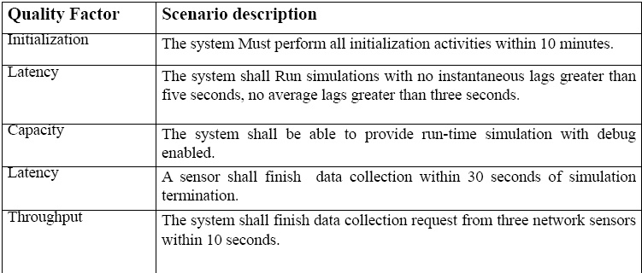
Scenario profile for performance

Slide 45
POS Case Study
Scenario(s): The POS system scans a new item, item is looked up, total price updated within two seconds
Stimulus Source : End user
Stimulus: Scan item, fixed time between events for limited time period
Environment: Development time
Artefact (If Known): POS system
Response: Item is looked up, total price updated
Response Measure: Within two seconds

Slide 46
Throughput
Measure of the amount of work an application must perform in unit time
Transactions per second (TPS)
Messages per second (MPS)
Is required throughput:
Average?
Peak?
Many system have low average but high peak throughput requirements

Slide 47
Response time
Measure of the latency an application exhibits in processing a request
Usually measured in (milli)seconds
Often an important metric for users
Is required response time:
Guaranteed?
Average?
E.g. 95% of responses in sub-4 seconds, and all within 10 seconds

Slide 48
Deadlines
‘something must be completed before some specified time’
Payroll system must complete by 2am so that electronic transfers can be sent to bank
Weekly accounting run must complete by 6am Monday so that figures are available to management
Deadlines often associated with batch jobs in IT systems.

Slide 49
Attention!
What is a
Transaction?
Message?
Request?
All are application specific measures.
System must achieve 100 mps throughput
BAD!!
System must achieve 100 mps peak throughput for PaymentReceived messages
GOOD!!!

Slide 50
Factors affecting performance
Resource Consumption
Blocked time
Contention for resources
Availability of resources
Dependency on other computation

Slide 51
Tactics to achieve performance
resource demand,
resource management
resource arbitration.

Slide 52
Resource demand
Increase computational efficiency.
Improving the algorithms,
Trading one resource for another.
Reduce computational overhead.
Use local class vs. RMI
Use of intermediaries => the classic modifiability/performance tradeoff.
Notes:
Increase computational efficiency. One step in the processing of an event or a message is applying some algorithm. Improving the algorithms used in critical areas will decrease latency. Sometimes one resource can be traded for another. For example, intermediate data may be kept in a repository or it may be regenerated depending on time and space resource availability. This tactic is usually applied to the processor but is also effective when applied to other resources such as a disk.
Reduce computational overhead. If there is no request for a resource, processing needs are reduced. In Chapter 17, we will see an example of using Java classes rather than Remote Method Invocation (RMI) because the former reduces communication requirements. The use of intermediaries (so important for modifiability) increases the resources consumed in processing an event stream, and so removing them improves latency. This is a classic modifiability/performance tradeoff.

Slide 53
Resource demand - reduce the number of processed events
Manage event rate.
Reduce the sampling frequency at which environmental variables are monitored
Control frequency of sampling.
If there is no control over the arrival of externally generated events, queued requests can be sampled at a lower frequency, possibly resulting in the loss of requests.

Slide 54
Resource demand – control the use of resources
Bound execution times.
Place a limit on how much execution time is used to respond to an event.
Bound queue sizes.
This controls the maximum number of queued arrivals and consequently the resources used to process the arrivals.

Slide 55
Resource management
Introduce concurrency.
process different streams of events on different threads
create additional threads to process different sets of activities.
appropriately allocate the threads to resources (load balancing)
Maintain multiple copies of either data or computations.
clients in a client-server pattern are replicas of the computation.
caching is a tactic in which data is replicated,
keeping the copies consistent and synchronized becomes a responsibility that the system must assume.
Increase available resources.
faster processors, additional processors, additional memory, faster networks.
Notes:
Introduce concurrency. If requests can be processed in parallel, the blocked time can be reduced. Concurrency can be introduced by processing different streams of events on different threads or by creating additional threads to process different sets of activities. Once concurrency has been introduced, appropriately allocating the threads to resources (load balancing) is important in order to maximally exploit the concurrency.
Maintain multiple copies of either data or computations. Clients in a client-server pattern are replicas of the computation. The purpose of replicas is to reduce the contention that would occur if all computations took place on a central server. Caching is a tactic in which data is replicated, either on different speed repositories or on separate repositories, to reduce contention. Since the data being cached is usually a copy of existing data, keeping the copies consistent and synchronized becomes a responsibility that the system must assume.
Increase available resources. Faster processors, additional processors, additional memory, and faster networks all have the potential for reducing latency. Cost is usually a consideration in the choice of resources, but increasing the resources is definitely a tactic to reduce latency. This kind of cost/performance tradeoff is analyzed in Chapter 12.

Slide 56
Resource arbitration - Scheduling
First In, First Out (FIFO).
queues that treat all requests equally (all have the same priority). Requests are ordered by time of arrival.
Fixed priority.
assign to each resource requester a priority, and treat the requests issued by high-priority requesters first.
Strategies:
semantic importance. Priority is assigned based on some domain characteristic.
deadline monotonic. This is a static strategy that assigns higher priority to requesters with shorter deadlines.
rate monotonic. This is a static strategy for periodic requesters; higher priority is assigned to requesters with shorter periods.

Slide 57
Resource scheduling
Dynamic priority.
ordering according to a criterion and then, at every assignment possibility, assign the resource to the next request in that order.
earliest deadline: the priority is assigned to the pending request with the earliest deadline.
Static scheduling.
determine the sequence of assignment offline.

Slide 58
Security
Security is a measure of the system's ability to resist unauthorized usage while still providing its services to legitimate users.
An attempt to breach security is called an attack

Slide 59
Security features
Nonrepudiation is the property that a transaction (access to or modification of data or services) cannot be denied by any of the parties to it.
Confidentiality is the property that data or services are protected from unauthorized access.
Integrity is the property that data or services are being delivered as intended.
Assurance is the property that the parties to a transaction are who they purport to be.
Availability is the property that the system will be available for legitimate use.
Auditing is the property that the system tracks activities within it at levels sufficient to reconstruct them.

Slide 60
Security scenario
Source - Individual or system
that is correctly identified, identified incorrectly, of unknown identity
who is internal/external, authorized/not authorized
with access to limited resources, vast resources
Stimulus - Tries to
display data, change/delete data, access system services, reduce availability to system services
Artifact - System services; data within system
Environment -
online or offline,
connected or disconnected,
firewalled or open

Slide 61
Security scenario continued
Response
Authenticates user; hides identity of the user; blocks access to data and/or services; allows access to data and/or services; grants or withdraws permission to access data and/or services; records access/modifications or attempts to access/modify data/services by identity; stores data in an unreadable format; recognizes an unexplainable high demand for services, and informs a user or another system, and restricts availability of services
Response Measure
Time/effort/resources required to circumvent security measures with probability of success; probability of detecting attack; probability of identifying individual responsible for attack or access/modification of data and/or services; percentage of services still available under denial-of-services attack; restore data/services; extent to which data/services damaged and/or legitimate access denied

Slide 62
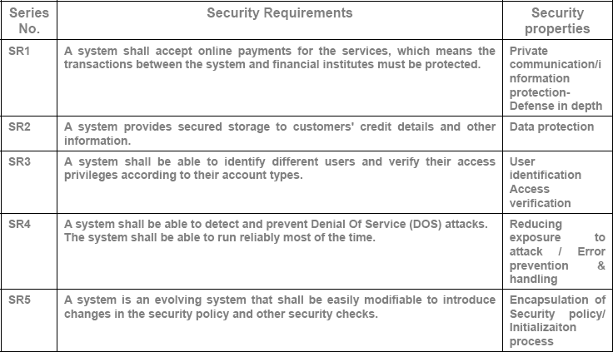
Security scenarios

Slide 63
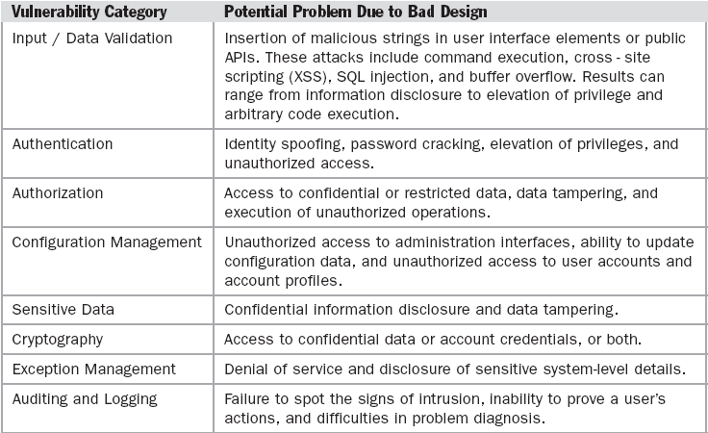
Dealing with Security Risks

Slide 64
Principles for Security Strategies

Slide 65
Principles for Security Strategies

Slide 66
Security tactics
Resisting attacks
Detecting attacks
Recovering from attacks

Slide 67
Resisting attacks
Authenticate users.
Ensure that a user or remote computer is actually who it purports to be. Passwords, one-time passwords, digital certificates, and biometric identifications provide authentication.
Authorize users.
ensure that an authenticated user has the rights to access and modify either data or services. This is usually managed by providing some access control patterns within a system. Access control can be by user or by user class. Classes of users can be defined by user groups, by user roles, or by lists of individuals.
Maintain data confidentiality.
encryption to data and to communication links. The link can be implemented by a virtual private network (VPN) or by a Secure Sockets Layer (SSL) for a Web-based link. Encryption can be symmetric (both parties use the same key) or asymmetric (public and private keys).

Slide 68
Resisting attacks
Maintain integrity.
Data should be delivered as intended. It can have redundant information encoded in it, such as checksums or hash results, which can be encrypted either along with or independently from the original data.
Limit exposure.
The architect can design the allocation of services to hosts so that limited services are available on each host.
Limit access.
Firewalls restrict access based on message source or destination port. It is not always possible to limit access to known sources. One configuration used in this case is the so-called demilitarized zone (DMZ).

Slide 69
Security tactics
Detecting attacks
Intrusion detection system
Recovering from attacks
restoring state (availability)
attacker identification (nonrepudiation)

Slide 70
Cloud-based security vulnerabilities
Identified by CSA, NIST and ENISA
Data Privacy and Reliability
Data Integrity
Authentication and Authorization
authentication frameworks like OpenID, SAML, Shibboleth

Slide 71
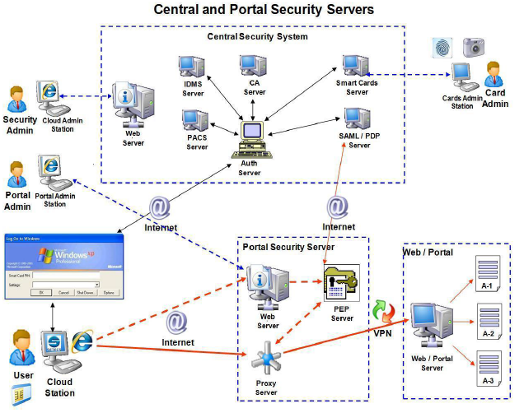
Cloud Security Infrastructure example

Slide 72
Other Quality attributes
Modifiability
Source: developer, administrator, user
Stimulus: add/delete/modify function or quality
Artifact: UI, platform, environment
Environment: design, compile, build, run
Response: make change and test it
Measure: effort, time, cost

Slide 73
Testability
Source: developer, tester, user
Stimulus: milestone completed
Artifact: design, code component, system
Environment: design, development, compile, deployment, run
Response: can be controlled and observed
Measure: coverage, probability, time

Slide 74
Example testability scenario
Source: Unit tester
Stimulus: Performs unit test
Artifact: Component of the system
Environment: At the completion of the component
Response: Component has interface for controlling behavior, and output of the component is observable
Response Measure: Path coverage of 85% is achieved within 3 hours

Slide 75
Usability
Source: end user
Stimulus: wish to learn/use/minimize errors/adapt/feel comfortable
Artifact: system
Environment: configuration or runtime
Response: provide ability or anticipate
Measure: task time, number of errors, user satisfaction, efficiency

Slide 76
Lessons learned
Requirements engineering is important and not trivial. Involves:
Elicitation
Specification
Validation
Architecture is driven by requirements:
Functional
Non-functional (quality attributes)
Quality attributes
Defined as scenarios
Achieved using appropriate tactics

Slide 77
Design trade-offs
QAs are rarely orthogonal
They interact, affect each other
highly secure system may be difficult to integrate
highly available application may trade-off lower performance for greater availability
high performance application may be tied to a given platform, and hence not be easily portable
Architects must create solutions that makes sensible design compromises
Not possible to fully satisfy all competing requirements
Must satisfy all stakeholder needs
This is the difficult bit!

